Slide 1

Python Sequences

Slide 2
Contents
List Introduction
List Operations
Tuple Introduction
Tuple Operations
Unpacking Sequence
Sequence Slicing
Sorting List
Searching Sequence

Slide 3
List Introduction
List is a sequence. But the word “collection” gives a better understanding about list
It stores values of same data type or different data types(just like a collection of all types of values).
List is iterable. Each index can be iterated using index number. It also allow iteration using negative index.
List is mutable. Elements of a list can be changed.

Slide 4
List Operations
Creating List
List can be created by placing the list elements inside square brackets separated by comma. Anything inside square bracket is considered as list elements. They can be number, string, object and another list.
lst=[1,3,4.5,'python']
Empty list can be created by assigning blank square brackets or using list( ) method.
lst=[]
lst=list()

Slide 5
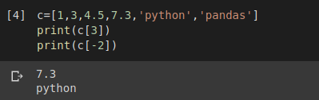
List Operations
Iterating List
List can be iterated using index number. It also allow iteration using negative index. Let’s consider a list named c.
normal iteration
c[0]
c[1]
c[2]
c[3]
c[4]
c[5]
1
3
4.5
7.3
python
pandas
c[-6]
c[-5]
c[-4]
c[-3]
c[-2]
c[-1]
iteration using negative index

Slide 6
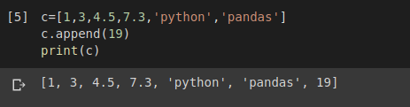
List Operations
Inserting into List
New elements can be inserted into list. This can be done using append( ) method. This method incerts the new value at the end of the list.
c.append(19)
c[0]
c[1]
c[2]
c[3]
c[4]
c[5]
c[6]
1
3
4.5
7.3
python
pandas

Slide 7
List Operations
List are mutable
The value of any index of a list can be replaced by another value using index number.
c[0]
c[1]
c[2]
c[3]
c[4]
c[5]
c[6]
1
3
4.5
7.3
python
pandas
19
c[0]
c[1]
c[2]
c[3]
c[4]
c[5]
c[6]
c[2] = 13
1
3
13
7.3
python
pandas
19

Slide 8
Tuple Introduction
Tuple is a sequence. Like as list, tuple is also known as collection.
It stores values of same data type or different data types.
Tuple is iterable. Each index can be iterated using index. It also allow iteration using negative index.
Tuple is immutable. Elements of a tuple can not be changed.

Slide 9
Tuple Operations
Creating Tuple
Tuple can be created by placing the elements inside parentheses separated by comma. The elements can be number, string, object and other mutable objects.
tp=(1,3,4.5,'python')
Empty list can be created by assigning blank parentheses or using tuple( ) method.
tp=()
tp=tuple()

Slide 10
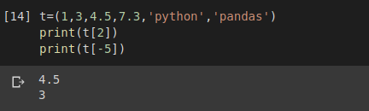
Tuple Operations
Iterating Tuple
Tuple can be iterated using index number. It also allow iteration using negative index. Let’s consider a tuple named t.
normal iteration
t[0]
t[1]
t[2]
t[3]
t[4]
t[5]
1
3
4.5
7.3
python
pandas
t[-6]
t[-5]
t[-4]
t[-3]
t[-2]
t[-1]
iteration using negative index

Slide 11
Tuple Operations
Inserting into Tuple
New elements can be inserted into tuple. This can be done using += operat. This incerts the new value at the end of the tuple.
t[0]
t[1]
t[2]
t[3]
t[4]
t[5]
1
3
4.5
7.3
python
pandas
t[0]
t[1]
t[2]
t[3]
t[4]
t[5]
t[6]
t[7]
t+=(19,28)
1
3
13
7.3
python
pandas
19
28

Slide 12
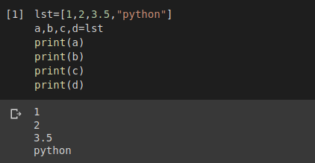
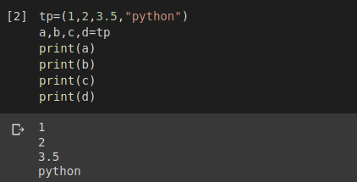
Unpacking Sequence
Elements of a sequence can be assigned to individual variables. But the number of variable and the number of elements should be same.

Slide 13
Sequence Slicing
A sequence can be sliced passing a range separated by colon inside square brackets. There are multiple slicing.
Slicing with starting and ending position: It slices from starting index to the previous of ending index.
c[0]
c[1]
c[2]
c[3]
c[4]
c[5]
c[1:4]
1
3
4.5
7.3
python
pandas
2. Slicing with no indices: It slices the whole sequence
c[0]
c[1]
c[2]
c[3]
c[4]
c[5]
c[:]
1
3
4.5
7.3
python
pandas

Slide 14
Continue...
3. Slicing with starting index: It slices from starting index to the last index.
c[0]
c[1]
c[2]
c[3]
c[4]
c[5]
c[2:]
1
3
4.5
7.3
python
pandas
4. Slicing with ending index: It slices from zero index to the previous of ending index.
c[0]
c[1]
c[2]
c[3]
c[4]
c[5]
c[:4]
1
3
4.5
7.3
python
pandas

Slide 15
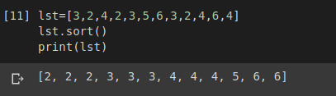
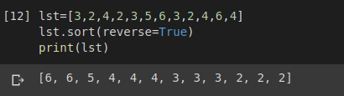
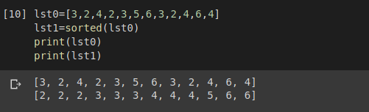
Sorting List
Sorting a list can be done in two ways. sort( ) method does the sorting but it rearranges the elements of the list in ascending order. That means in this method, the unordered list will be lost if not stored separately. To sort in descending order, we can set reverse parameter True.
A list can be sorted using built-in function sorted( ). This function creates a new sorted list. So, we do not need to store the unordered list separately.

Slide 16



Searching Sequence
We can search for an element inside a list. index( ) method does this work.It returns the index of first occurrence of search keyword.
We can specify the search area that means starting position and ending position of search inside a list.
When we did not specify the search range, it starts the search from index 0 and returns the first occurence of 3 at index 0. But in the second code, when we specify the search range from 2 to 8, it search from index 2 to index 7 and returns the first occurence of 3 at index 4.

Slide 17
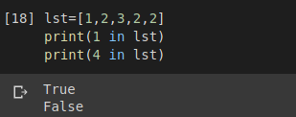
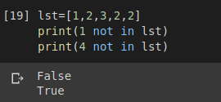
Continue...
We can check if an element exists in a list or not with in and not in operator. In operator returns True if the element exists, otherwise it returns False.
not in operator returns True if the element does not exist in the list, otherwise it returns False.

Slide 18
Thank You

